Slide 1
Acquisition
Acquisition of digital evidence is a crucial first step in any digital forensics investigation. It involves collecting data from various electronic devices while ensuring it remains unaltered for legal purposes.

Slide 2
Three types of data
Active data: the data that you deal with easily such as files, programs, operating system logs.
Archival: such as hard drives, tapes and CDs.
Latent: deleted files.

Slide 3
Order of volatility
When collecting evidence you should proceed from the volatile to the less volatile. Here is an example order of volatility for a typical system.
registers, cache
routing table, arp cache, process table, kernel statistics, memory
temporary file systems
disk
remote logging and monitoring data that is relevant to the system in question
physical configuration, network topology
archival media
https://datatracker.ietf.org/doc/html/rfc3227

Slide 4
Imaging
Imaging means create a copy of the evidence.
Create two copies (aka images) of the evidence. Because of one of them is altered then you can use the other one.
Use different tools to acquisition.

Slide 5
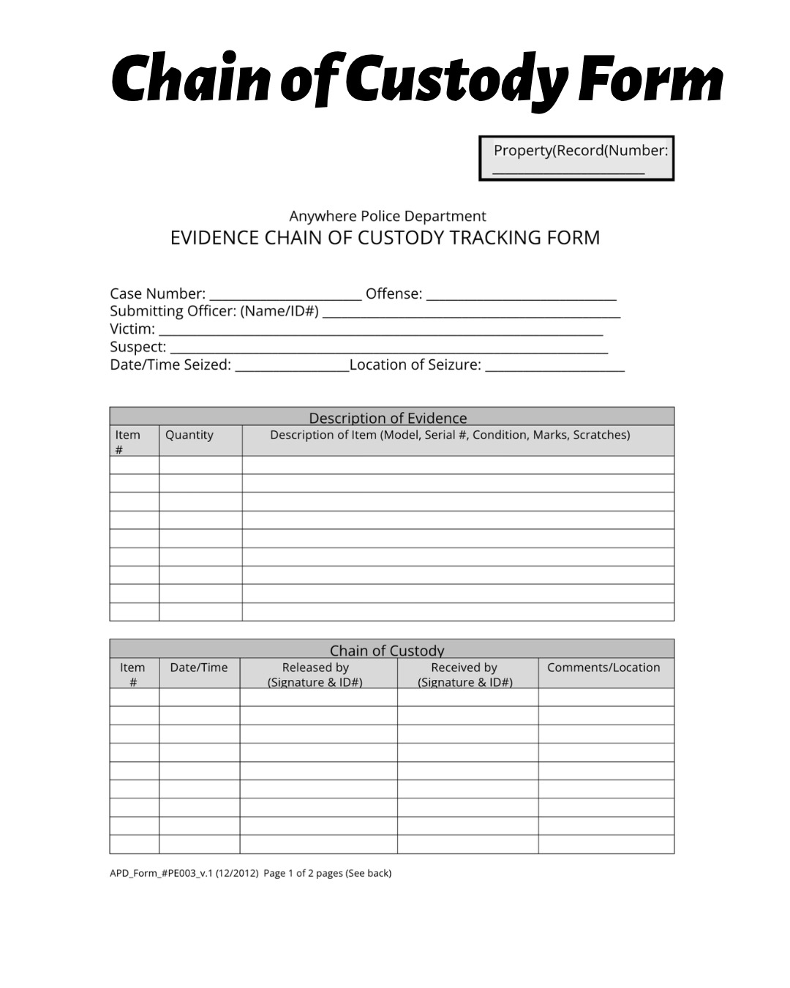



Don’t forget the CoC!
https://www.buddingforensicexpert.in/2023/06/chain-of-custody.html

Slide 6
Write blocker
Which device type you intend to image from will determine what write blocker to use. There are two basic types of write blockers:
Hardware write blocker: The hardware blocker is a device that is installed that runs software internally to itself and will block the write capability of the computer to the device attached to the write blocker. Example: SAFE block.
Software write blocker: The software blocker is an application that is run on the operating system that implements a software control to turn off the write capability of the operating system. Example: FastBlock.

Slide 7
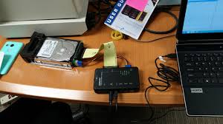
Hardware write blocker

Slide 8
Validation of data acquisition
The integrity check of the validity of the evidence can be done by calculating the hash value.
Some acquisition tools provide an option to calculate the hash value such as FTK Imager and Encase.

Slide 9
Acquisition methods
Local vs Remote
Local: When you have physical access to the target machine.
Remote: When you need to connect over the network to get access to the target machine.

Slide 10
Acquisition methods
Physical vs Logical
Physical: copy the hard drive bit-by-bit, all zeros and one on the hard drive will be copied. In this case, the resulted image is the same size as the original hard drive. Example: if the hard drive is 500GB then the image is 500 GB too.
Logical: copy part of the hard drive, some files or some volumes. This is the case when the hard drive has a big size.

Slide 11
FTK Imager
https://www.exterro.com/digital-forensics-software/ftk-imager

Slide 12
NirSoft
https://www.nirsoft.net/utils/hash_my_files.html

